Slide 1
Detector
Detector
Pin-Hole 1
Pin-Hole 1
LASER Source
LASER Source
Half Mirror
Half Mirror
Pin-Hole 2
Pin-Hole 2
Convex Lens
Convex Lens
Sample
Sample
Scanning
Scanning

Slide 2
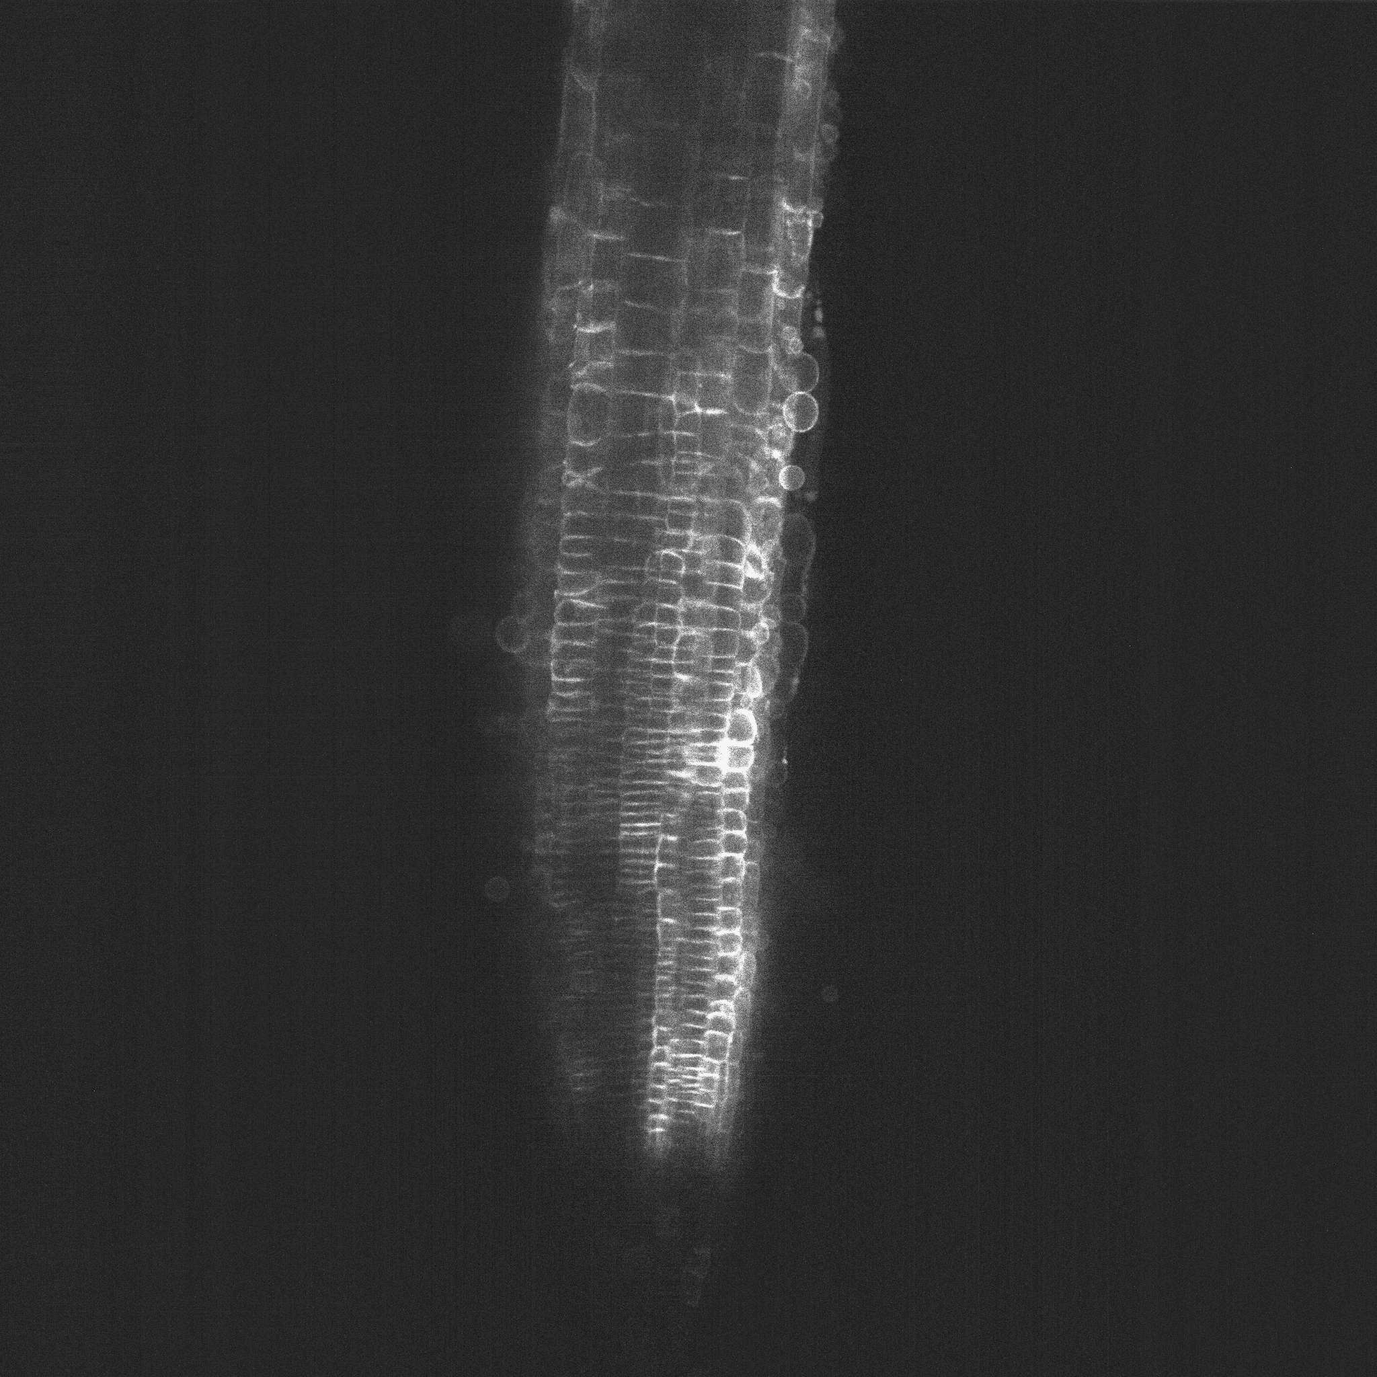







Slide 3
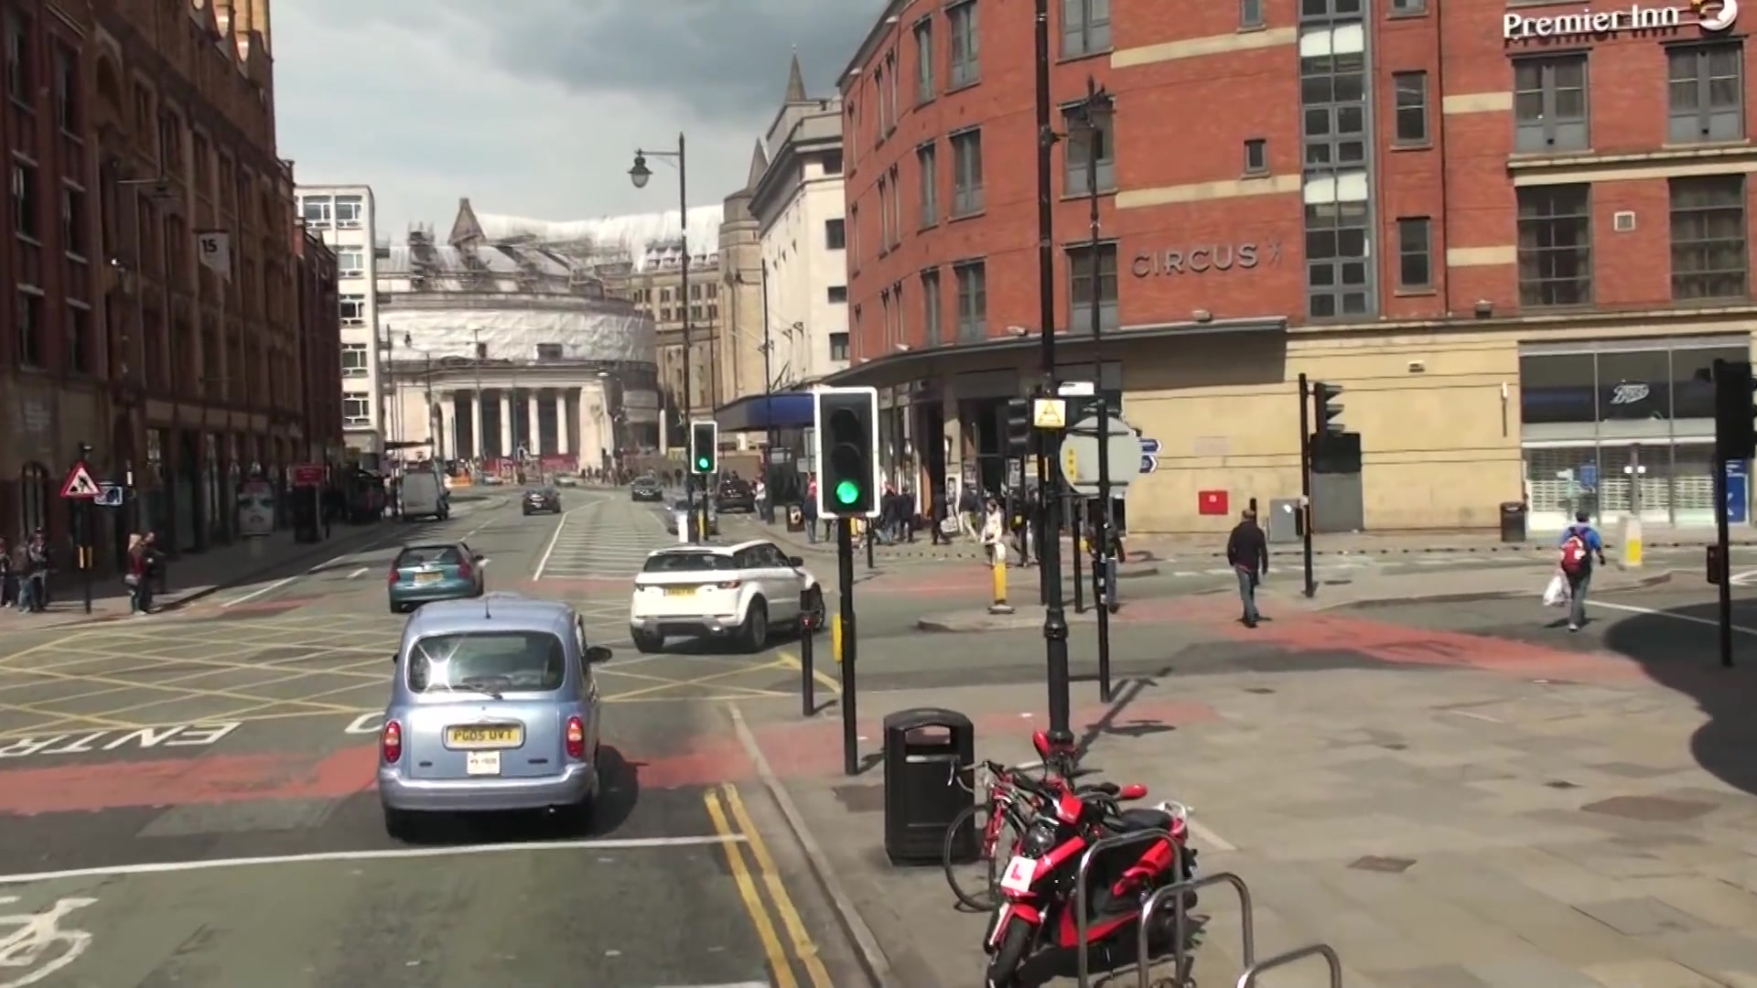


Original image
Segmentation mask

Slide 4
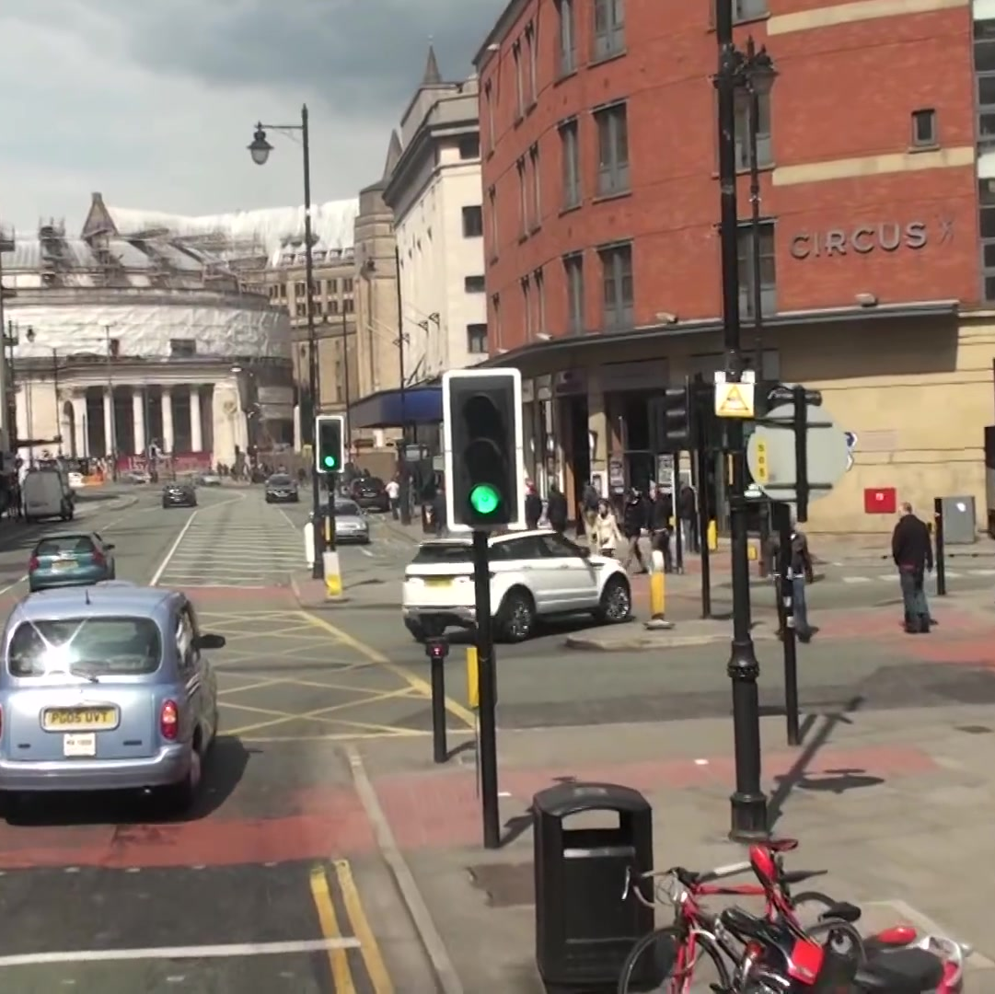
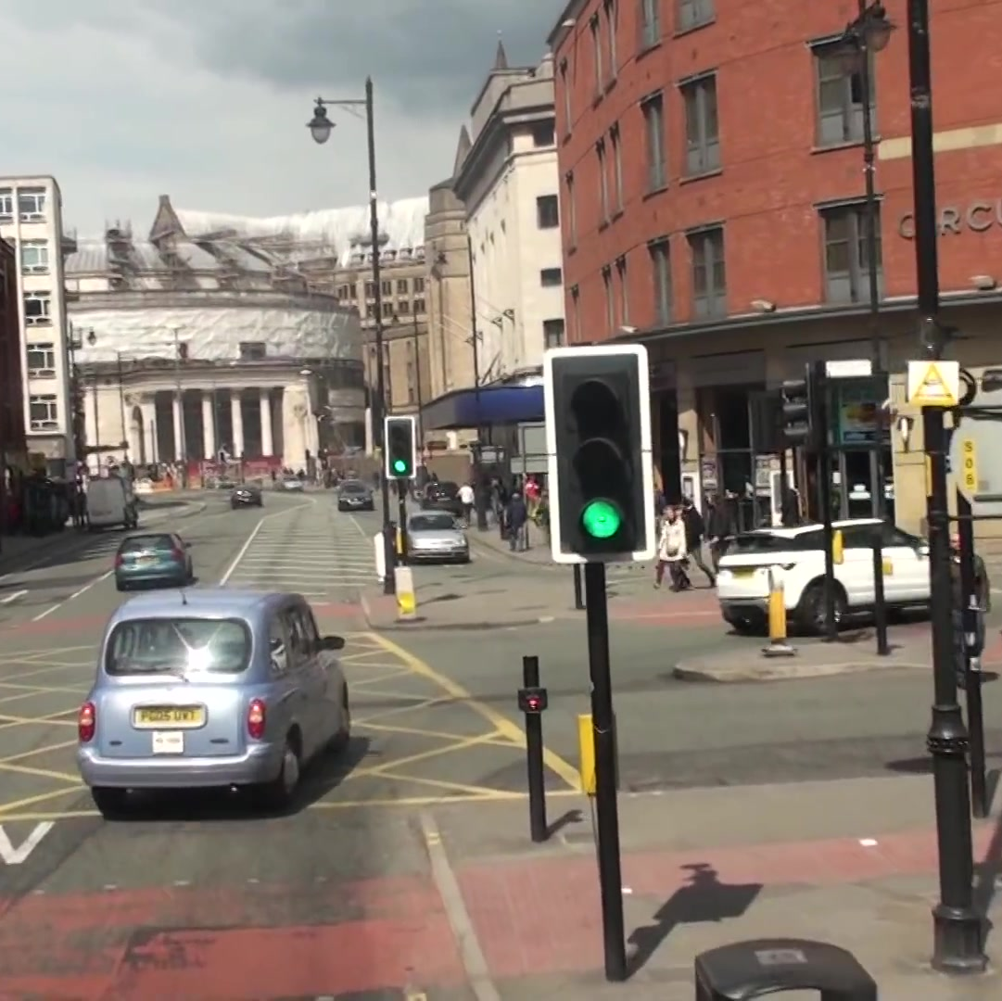
(1) Object Detection
(2) Re-Identification

Slide 5
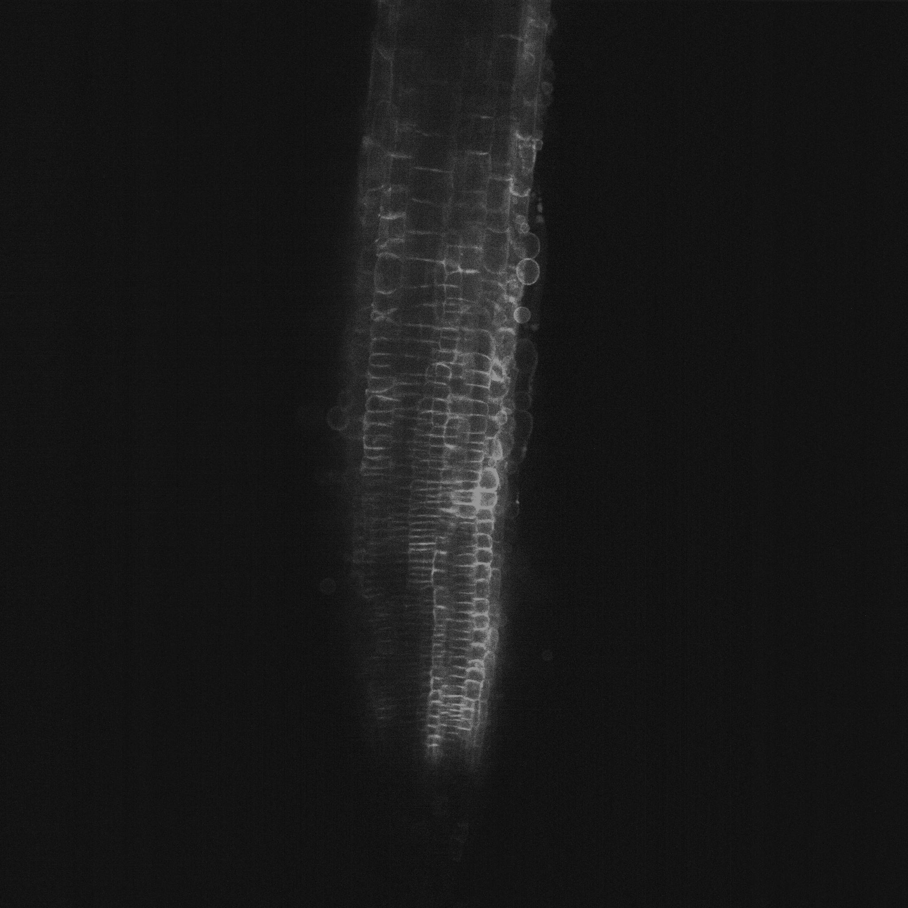
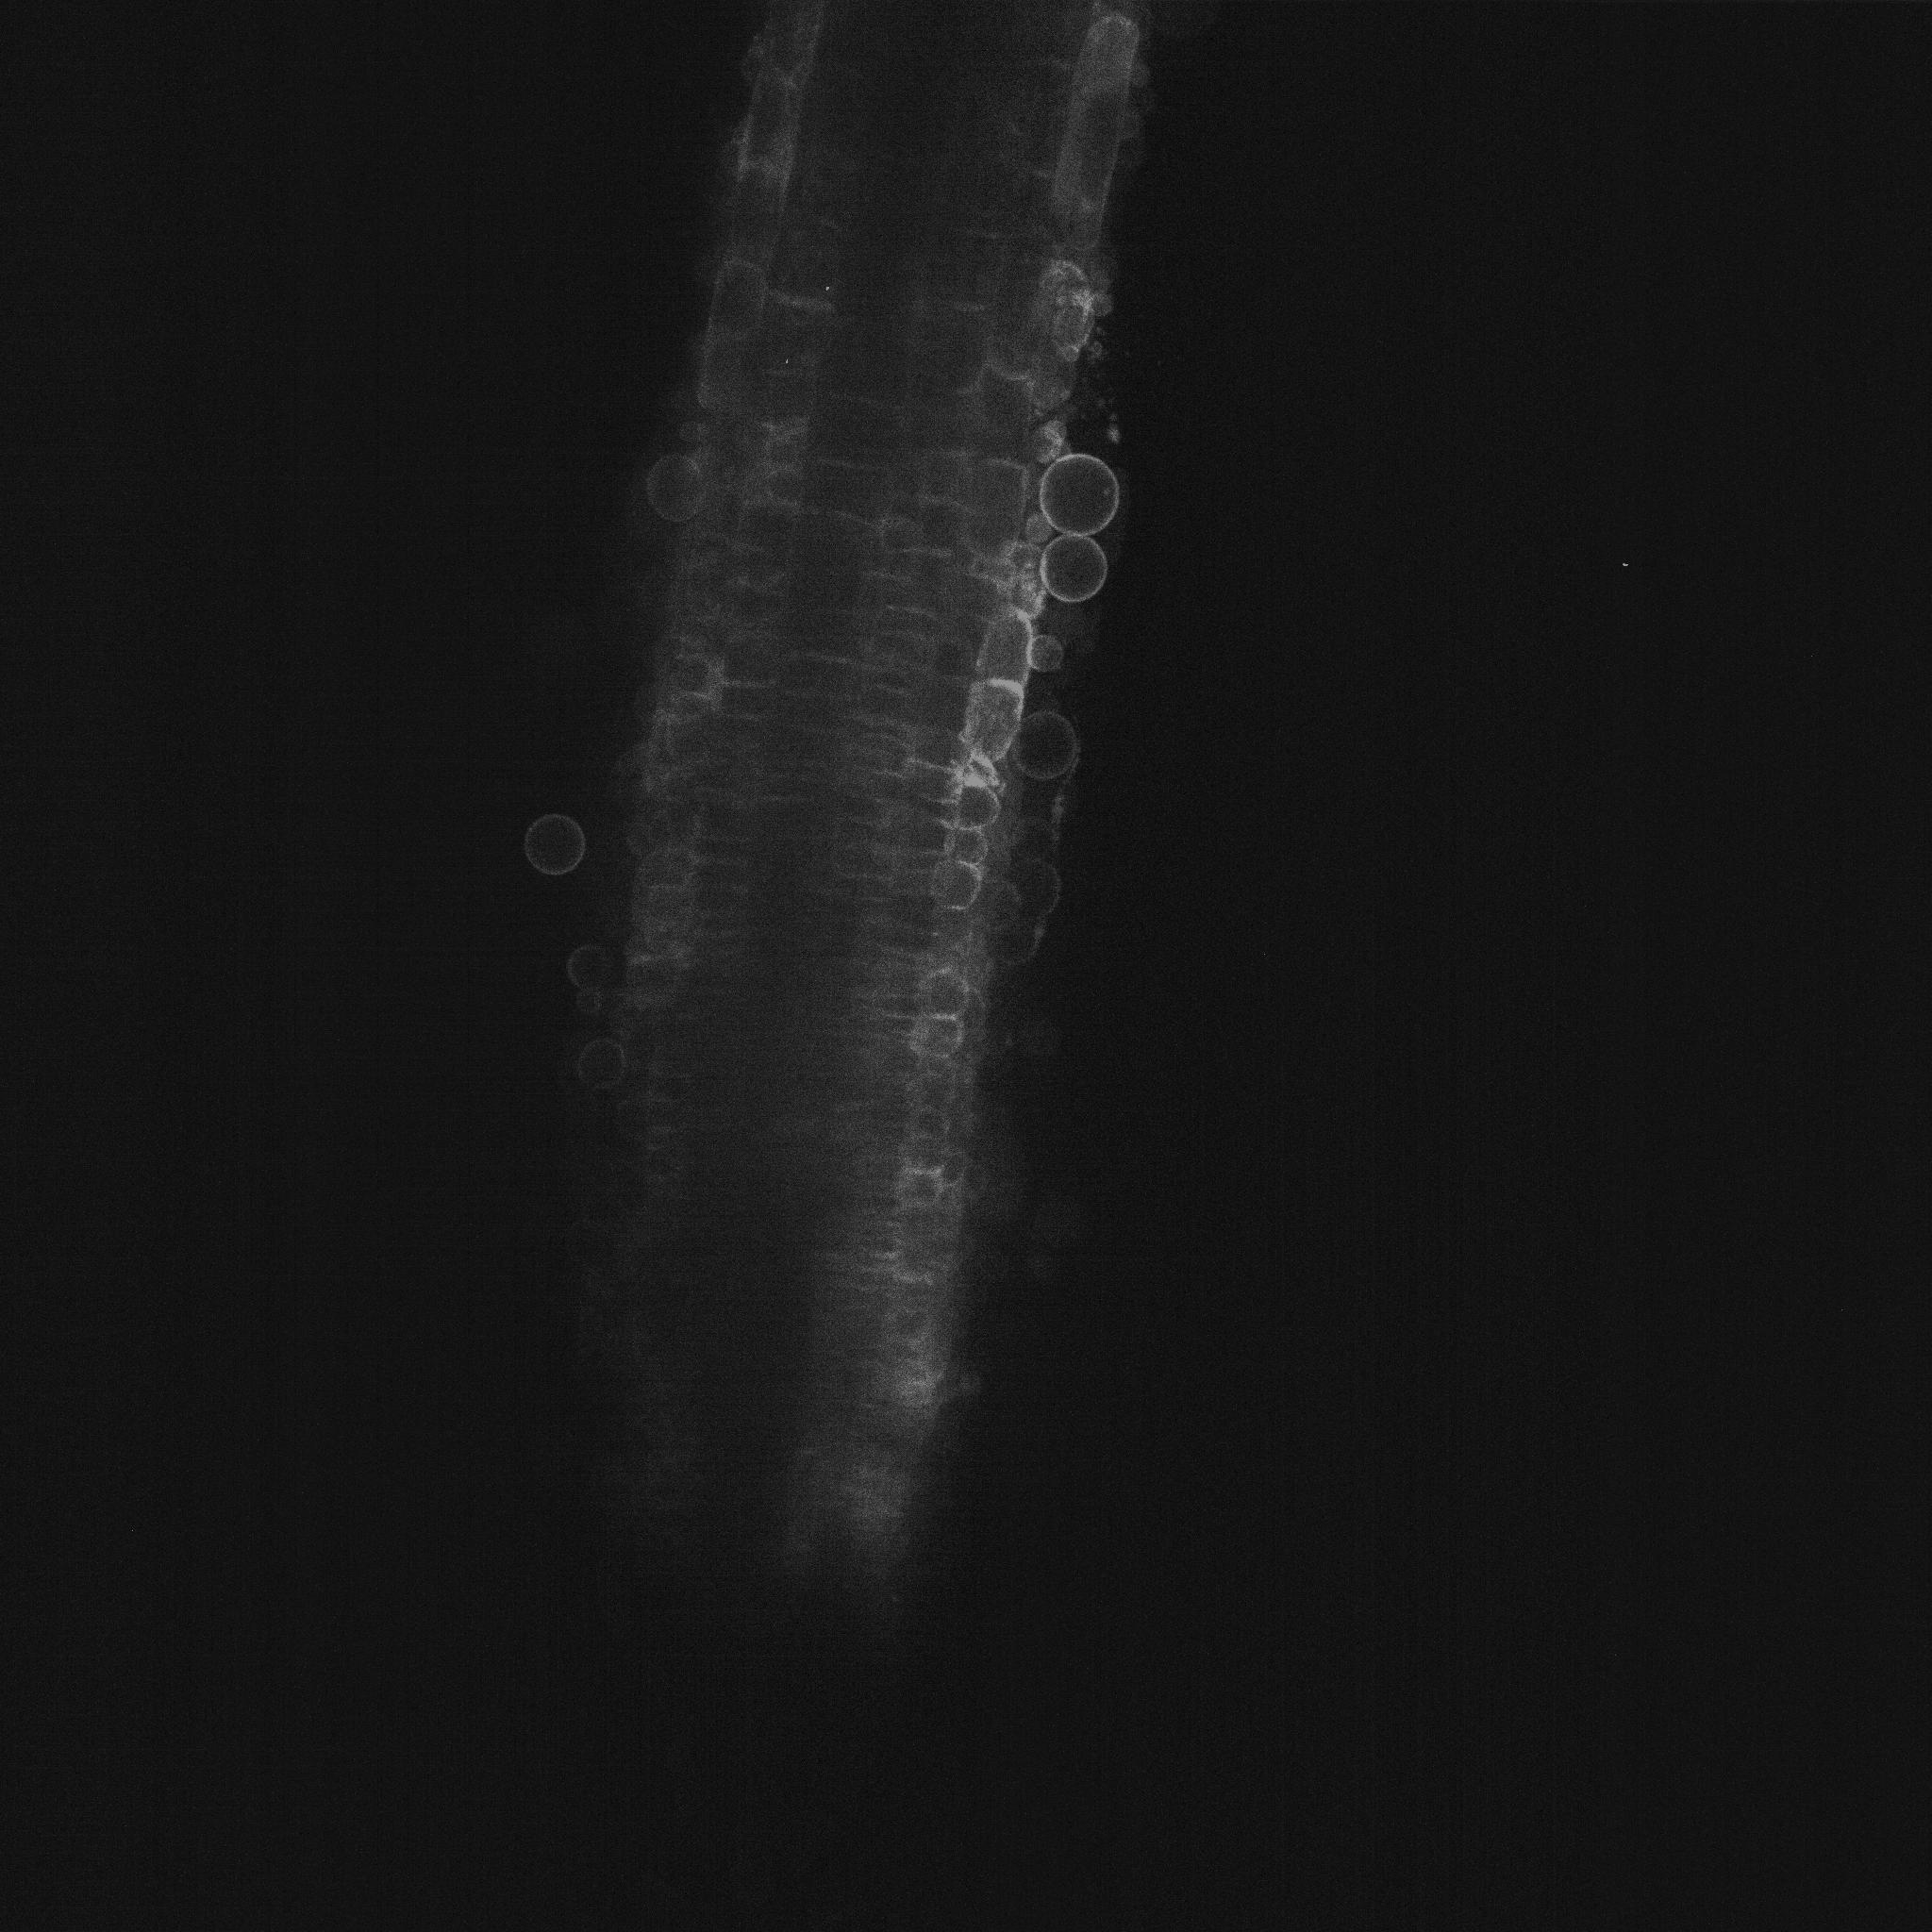


The same individual
Segmentation mask
Tracked positions
Original image
Segmentation mask

Slide 7
SORT with only one slice
With multiple slices
☓ Cannot estimate 3D state variables
◯ 3D state variables can be predicted

Slide 8
1. Predict
2. Matching
3. Update

Slide 9
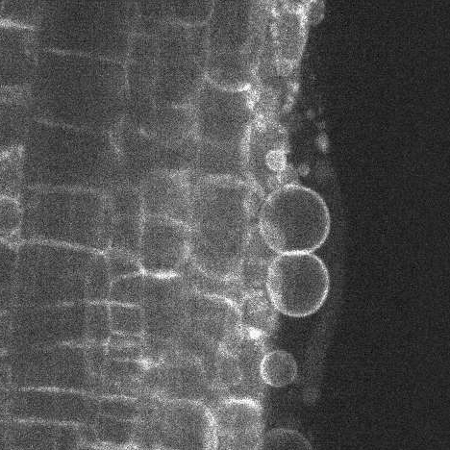
- Detection -
- ID Assignment -
- Estimation -
ID: 1
ID: 4
ID: 5

Slide 10
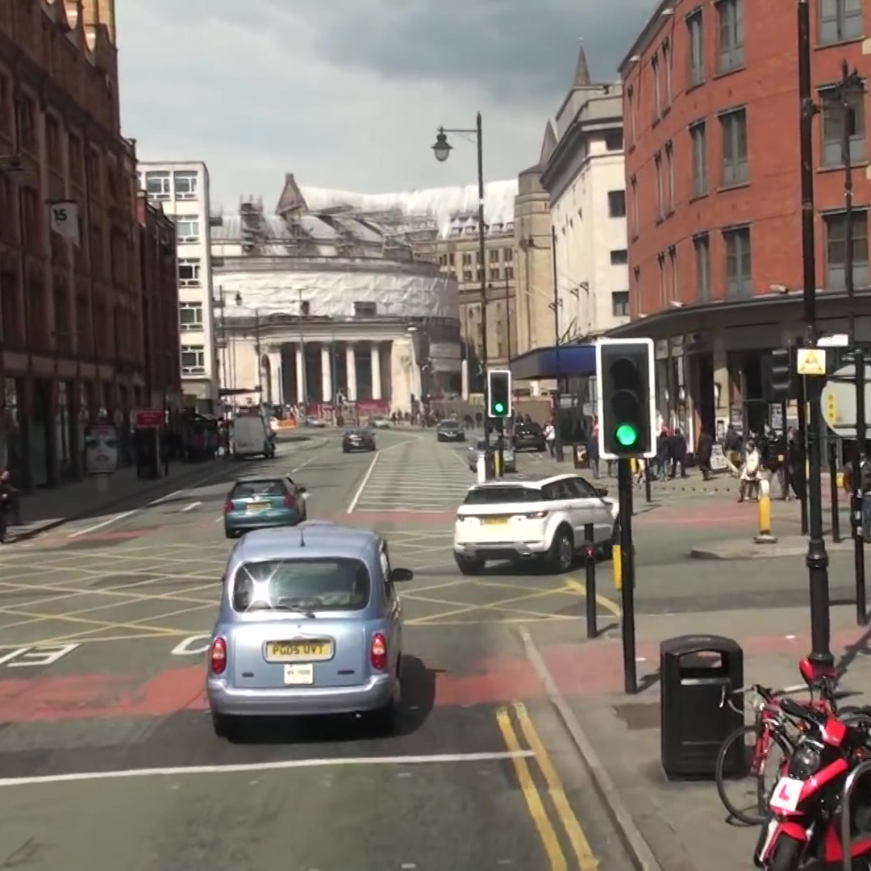
image
Backbone
Head
Non-Maximum
Suppression

Slide 11
1. Pre-Training
1. Fine-Tuning
training
(only red)
training
Large Dataset
Small Dataset
Good Parameters
Replace Parameters

Slide 12
・・・
(1) Object Detection
Object Detector
・・・
・・・
Matching
(2) Re-Identification
Bounding Box Prediction
・・・
(3) State Estimation
Observation Variables
Update State Variables

Slide 13
Good Case
Object is born
Bad Case
Object is born

Slide 14
Time-directional matching
Predicted bounding-boxes
Refer to other slices
Depth-directional matching
(Depth-SORT)
Detected bounding-boxes

Slide 15
Only TP
With FP
With FN

Slide 16
SORT + DepthSORT
SKF + DepthSORT （一部抜粋）
only SKF
only SORT

Slide 17
(a)
(b)
(c)
(d)

Slide 18
With DepthSORT
Without DepthSORT

Slide 19
Without DepthSORT
With DepthSORT

Slide 24
Size n
Size s
Size m
Size b
Size l
Size x

Slide 25


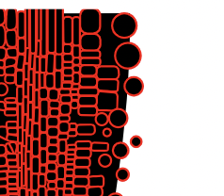
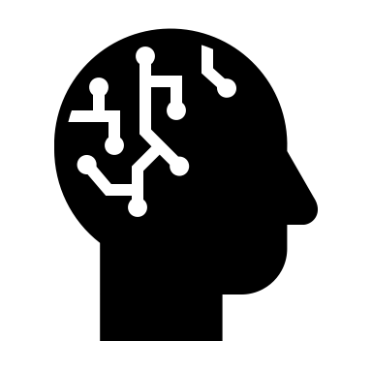
顕微鏡画像を取得
ロボットで一つずつ分取
AI
遊離前の位置を特定
リアルタイムで遊離細胞の位置を特定

Slide 26
